Slide 1
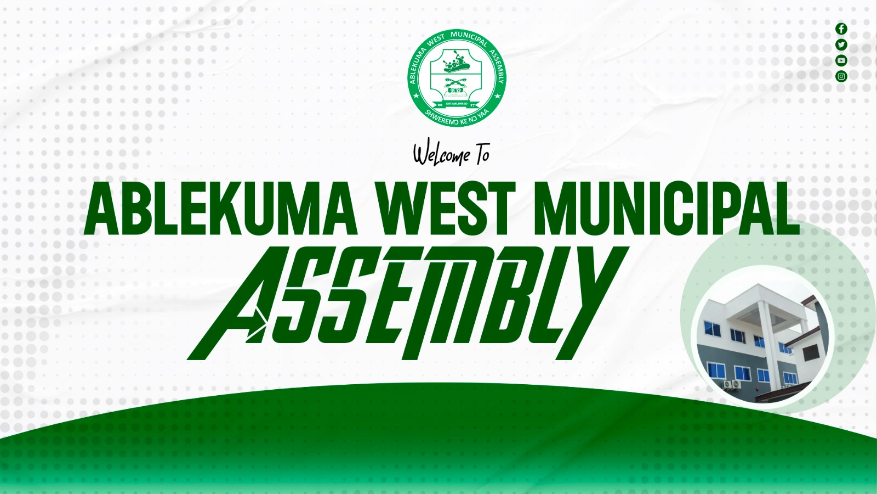
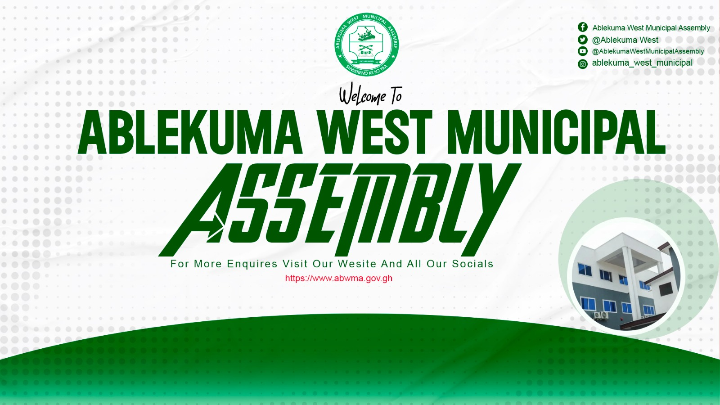

Slide 2

GENERAL SERVICES BY ABWMA

Slide 3
General Services by the Assembly Under the Local Governance Act, 2016 (Act 936) Ablekuma West Municipal Assembly

Slide 4
Mandate for Service Delivery Section 12 of Act 936:
MMDAs shall exercise political and administrative authority in the district and provide services for the overall development of the district.
Guiding Principle: Services must be efficient, transparent, and responsive to community needs.

Slide 5
Development Planning & Infrastructure Physical Planning:
Issue building permits, control development, prepare local plans – Section 12(3)(a)
Roads & Drains: Construction and maintenance of feeder roads, drains, and culverts Public Works:
Street lighting, community centers, markets, lorry parks Development Control:
Prevent unauthorized structures and enforce planning schemes

Slide 6
Health & Sanitation Services Environmental Health & Sanitation
Section 12(3)(d)Waste collection and disposal management Public toilet maintenance and construction
Food safety inspection & hygiene education Public Health:
Support for CHPS compounds, health education campaigns Register births/deaths

Slide 7
Education, Youth & Social Services Education Support
– Section 12(3)(c)
Construction/maintenance of basic school infrastructure School feeding programme coordination
Social Welfare & Community Development PWDs support through DACF allocation
LEAP programme facilitation
Child protection & family welfare services
Youth & Sports: Youth resource centers, sports development

Slide 8
Services by the Assembly

Slide 9
Economic Development Services
– Section 12(3)(b)
Business registration support & Business Advisory Centre (BAC)Skills training: e.g. AI training, vocational programs Market development & SME support
Agriculture: Extension services, farmer support, aquaculture promotion
Trade & Tourism: Promote local industry, regulate markets

Slide 10
Revenue Mobilization & Licensing Internally Generated Funds (IGF)
– Section 124-145
Property rates collection,
Business Operating Permits (BOP),
Market tolls,
lorry park fees,
building permit fees
Licensing Services: Food vendors, artisans, hospitality, advertising

Slide 11
Safety, Security & Disaster Management Security
– Section 12(3)(g)
Coordinate with Police, Fire Service via MUSEC
Install & maintain street lights for public safety
Disaster Prevention & Management – Section 12(3)(f)NADMO
coordination for floods, fires, emergencies
Public education on disaster risk reduction By-law enforcement: Assembly task force, city guards

Slide 12
Environmental & Natural Resource Management Natural Resource Conservation
– Section 12(3)(e)
Tree planting & greening initiatives
Coastal/beach management
where applicable Control of sand winning & quarrying
Climate Action: Local climate adaptation projects
Environmental protection by-law enforcement

Slide 13
Citizen Engagement & Administrative Services Client Service Unit
Birth/death registration,
marriage certificates,
Public Engagement – Section 40-42
Town hall meetings & public hearings Public Relations & Complaints Committee (PRCC)
Access to Information: Assembly proceedings, budgets made public Sub-district structures:
Zonal Councils bring services closer to people

